Slide 1
DNA
Deoxyribonucleic Acid

Slide 2
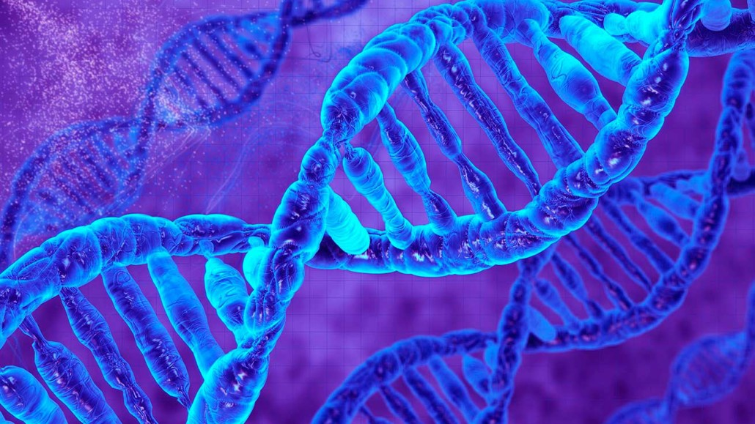
History!

Slide 3
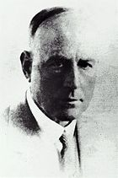
Frederick Griffith
1928 – Frederick Griffith was trying to figure out how bacteria made people sick.
Pneumonia – infection that inflames air sacs in one or both lungs, which may fill with fluid.

Slide 4
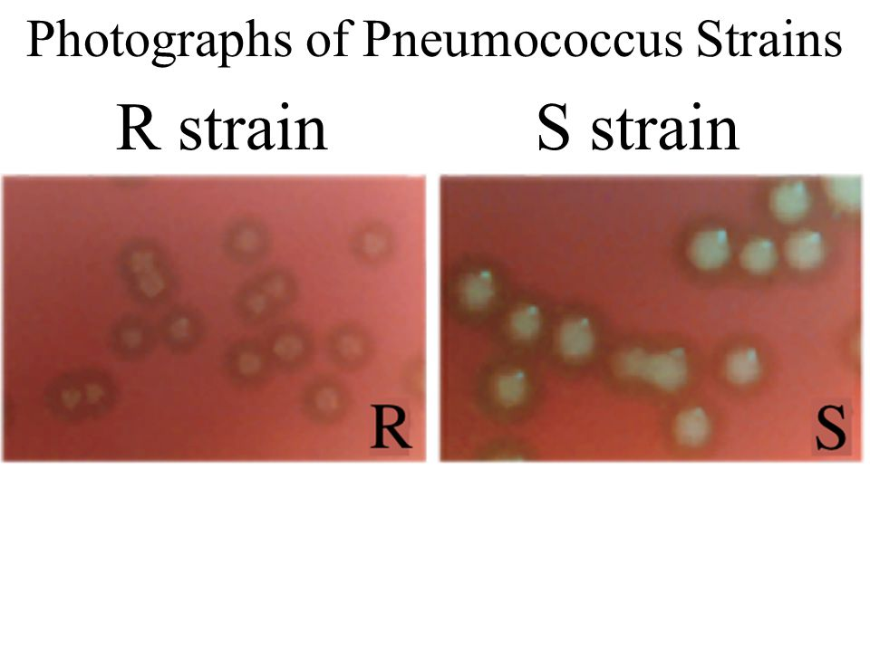
Frederick Griffith
Found two strains of bacteria of the same species
Smooth (S strain)
Rough (R strain)
Only the smooth strain caused pneumonia

Slide 5
Frederick Griffith
Experimented with mice.
When he injected the mice with the smooth bacteria, it caused pneumonia
When he injected the mice with the rough bacteria, the mice remained healthy
He “heat treated” the smooth bacteria
This killed the smooth bacteria cells
He injected the “heat treated” smooth bacteria into the mice
They remained healthy

Slide 6
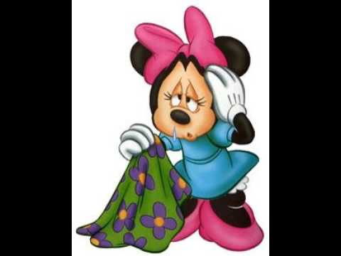
Frederick Griffith
Next experiment:
He mixed the “heat treated” smooth bacteria with the harmless rough bacteria
Injected this mix into the mice
SHOCKING RESULTS!!!!!!
This mix actually made the mice sick
How could this happen if the S-strain cells were dead?

Slide 7
Frederick Griffith

Slide 8
Frederick Griffith
Was it possible that the dead smooth cells genetically transformed the living rough bacteria cells?

Slide 9
Transformation
Griffith reasoned that when he mixed the “heat treated” smooth bacteria and the rough bacteria cells, a chemical factor had been transferred from the smooth bacteria cells to the rough bacteria cells
This is called transformation.
This chemical factor must contain information that could change the harmless bacteria into disease-causing bacteria

Slide 10
Oswald Avery
1944 - Avery’s team conducted experiments to narrow down the chemical compound that caused the transformation in the bacteria cells.
They treated the bacteria with enzymes that killed proteins, lipids, carbohydrates and other molecules
Transformation still happened
When they destroyed DNA (deoxyribonucleic acid), transformation did not occur
DNA WAS THE TRANSFORMING FACTOR!!!

Slide 11
Virus – tiny, nonliving particles that can infect living cells
Bacteriophage – a kind of virus that infects bacteria.

Slide 12
Hershey and Chase
Alfred Hershey and Martha Chase conducted experiments on bacteriophage viruses
Their experiments proved that DNA was the cell’s genetic material in all living cells

Slide 13
How could DNA be capable of doing the following with genetic information in the cell?
Storing
Copying
Transmitting

Slide 14
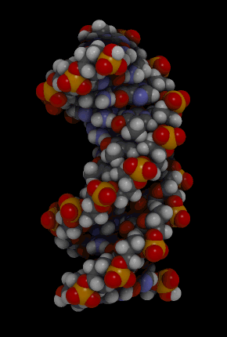
The Structure of DNA

Slide 15
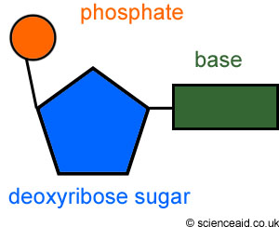
The components of DNA
DNA – a nucleic acid made up of nucleotides joined into long strands or chains by covalent bonds
Nucleotides are made up of three basic components:
5-carbon sugar – deoxyribose
A phosphate group
A nitrogenous base
Adenine
Guanine
Cytosine
Thymine

Slide 16
The Structure of DNA

Slide 17
Erwin Chargaff
Chargaff conducted experiments and found that:
Adenine (A) and Thymine (T) were found in equal amounts
Guanine (G) and Cytosine (C ) were found in equal amounts

Slide 19
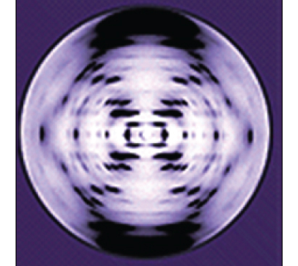
Rosalind Franklin
1952: Used x-ray diffraction to show the pattern of DNA
Helix – twisted like the coils of a spring
1953: James Watson and Francis Crick used Franklin’s X-ray pattern to build a model of the specific structure of DNA

Slide 20
Structure of DNA
Double Helix – two strands coiled to resemble a twisted ladder
“Legs of the ladder” – Phosphate and Sugar
“Rungs of the ladder” – Nitrogenous base pairs
Nitrogenous bases held together with weak hydrogen bonds
The “legs” and “rungs” together made nucleotides.

Slide 21
Antiparallel Molecule
Antiparallel molecule – the two strands run alongside each other, but point in opposite directions.
In a double-stranded DNA molecule, the 5' end (phosphate-bearing end) of one strand aligns with the 3' end (hydroxyl-bearing end)

Slide 23
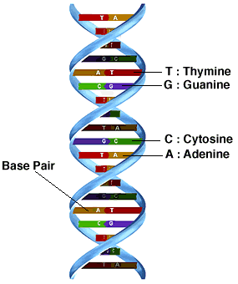
Base Pairings
Adenine (A) pairs with Thymine (T)
A=T
Guanine (G) pairs with Cytosine (C )
G=C

Slide 24
Base Pairings
Pyrimidines:
Thymine (T)
Cytosine (C )
Purines
Adenine (A)
Guanine (G)
Pyrimidines pair with Purines!

